Slide 1
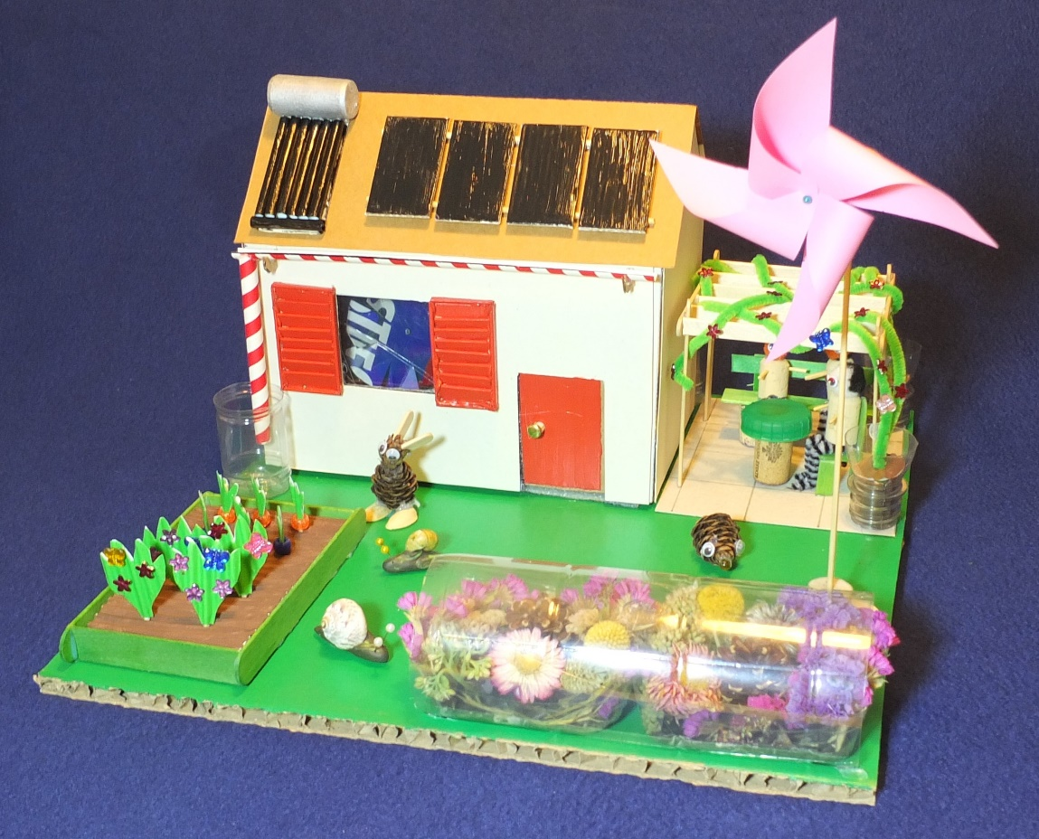
Designing an eco-home
An eco-home is one which has minimal impact on the environment.
This PowerPoint and the activities you have conducted should give you some ideas to help you design your own eco-home.
Notes:
The photo of a model eco-home is by Alex Alliston

Slide 2
Learning objectives
Understand the scientific basis for the technologies needed to make an eco-home.
Understand how these technologies are used in practice.
Generate design criteria then design your own eco-home based on these criteria.
Communicate and present your ideas.
Notes:
The eco-house icon Is from Pixabay (link: https://pixabay.com/vectors/house-home-building-architecture-157112/)

Slide 3
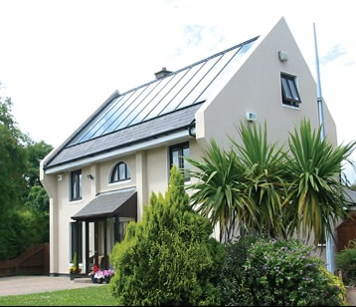
Some considerations for your eco-home
Keeping warm in winter
Keeping cool in summer
Rainwater harvesting
Minimising energy use
Renewable energy
Using your outside space
Notes:
If you live in a cool climate then keeping your house warm will be a key consideration.
If you live in a hot climate then keeping your house cool will be critical.
It is possible to design a house for both keeping warm in winter and cool in summer.
Considerations of heating and cooling should be an integral part of the design of the house to minimise the energy required for this.
Generate your own renewable energy if possible.
Rainwater harvesting can reduce your usage of mains water, whilst helping to reduce water shortages and flooding.
If you live in a climate where it snows then remember to have a sloping roof to help the snow slide off.
The photo is from Wikimedia (link: https://upload.wikimedia.org/wikipedia/commons/7/75/Knocklyon_Solar_House.jpg)

Slide 4
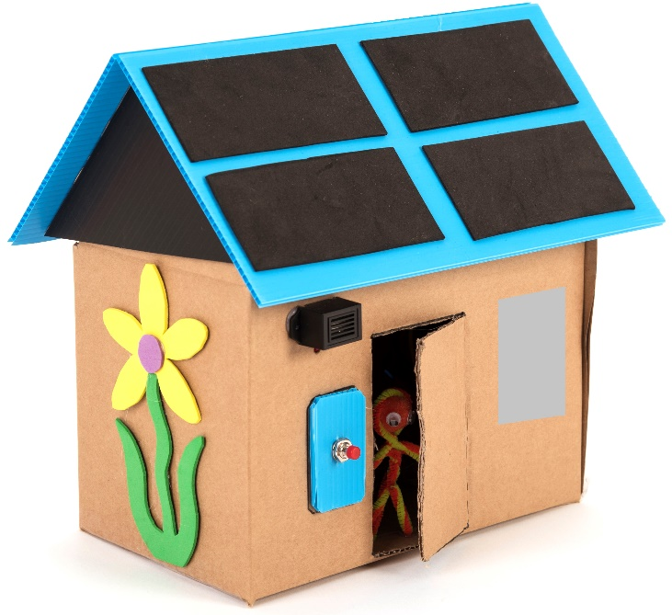
Keeping warm in winter
Thick loft insulation
Describe what you discovered during Activity 1 (investigate heat insulation).
Here are some ways to stop heat escaping from your home.
Wall insulation (e.g. cavity wall insulation or internal/ external wall insulation)
Double or triple glazed windows
Draught exclusion on doors
Under floor insulation
Notes:
Ask pupils to explain what they did in Activity 1 (investigate heat insulation) and what they found out.
The insulated mug of water cooled down more slowly because the insulation helped retain the heat.
You could have retained the heat better by adding more insulation and/or using more effective insulating materials.
Typically, in a poorly insulated house about 25% of heat is lost through the roof, 10% through windows and doors, 15% through the floor, 35% through the walls and 15% through draughts.
The main ways to reduce heat loss are shown on the diagram.
Designing a very well insulated house can help it to stay both warm in winter and cool in summer.
This image is from the TTS Build-a-House class kit (link: https://www.tts-group.co.uk/build-a-house-class-kit-/1017004.html)

Slide 5
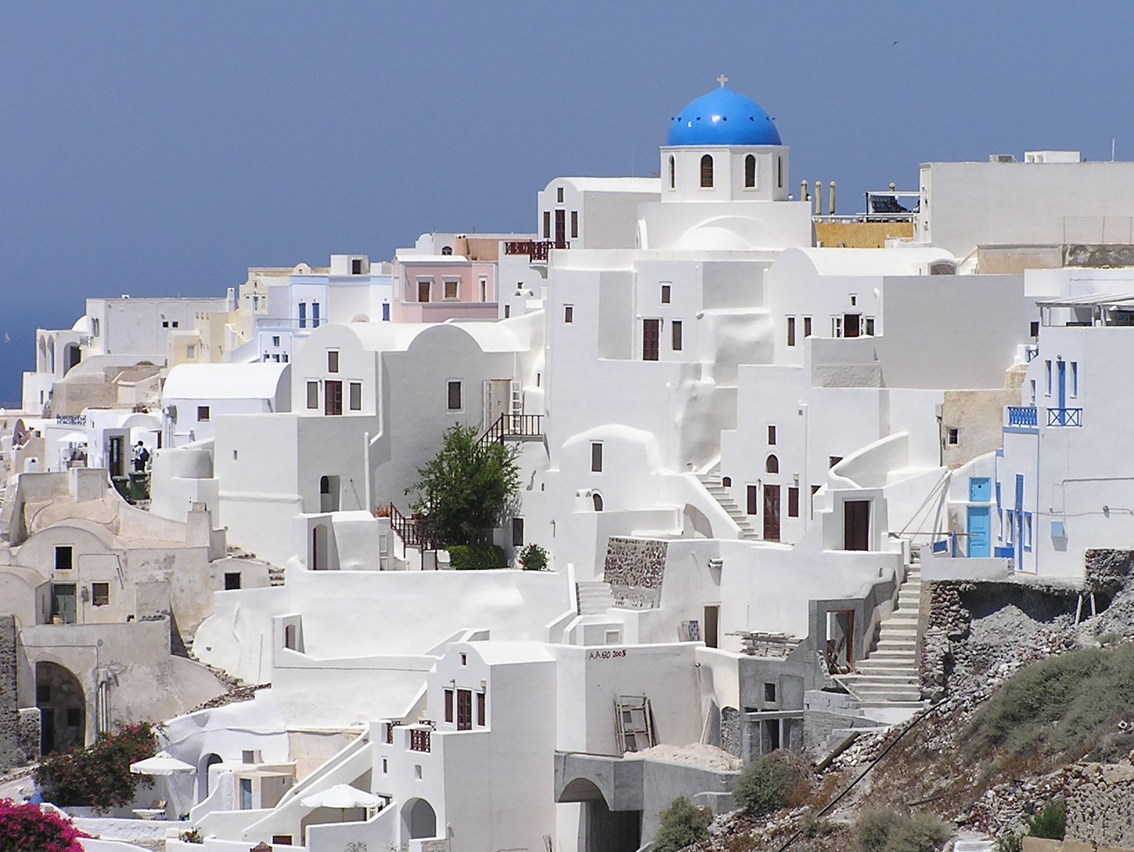
Keeping cool in summer
Describe what happened in Activity 2 (colour and solar heating).
What is the best colour to keep your house cool in summer?
Are there other ways to keep your house cool?
Notes:
Ask pupils to explain what happened in Activity 2 (investigate the relationship between colour and solar heating).
Light colours reflect more of the sun’s rays, whilst darker colours absorb more of the sun’s rays so they heat up more in the sun.
(Sunlight contains all colours of the rainbow mixed together. A white surface reflects all the colours so it stays cooler, whilst a black surface reflects none of the colours and gets hotter. A red surface, for example, reflects red light and absorbs the other colours.)
Transparent sticky tape was needed because this allowed the light to pass through.
Painting your house white or light coloured should help it to stay cooler in summer.
Other ways to help keep your house cool include using blinds, shades or overhangs to cover the windows or vents to allow air flow. You can also use a fan or air conditioning.
The photo of Santorini in Greece is from Wikimedia (link: https://commons.wikimedia.org/wiki/File:Oia-Santorini-Greece.jpg)

Slide 6
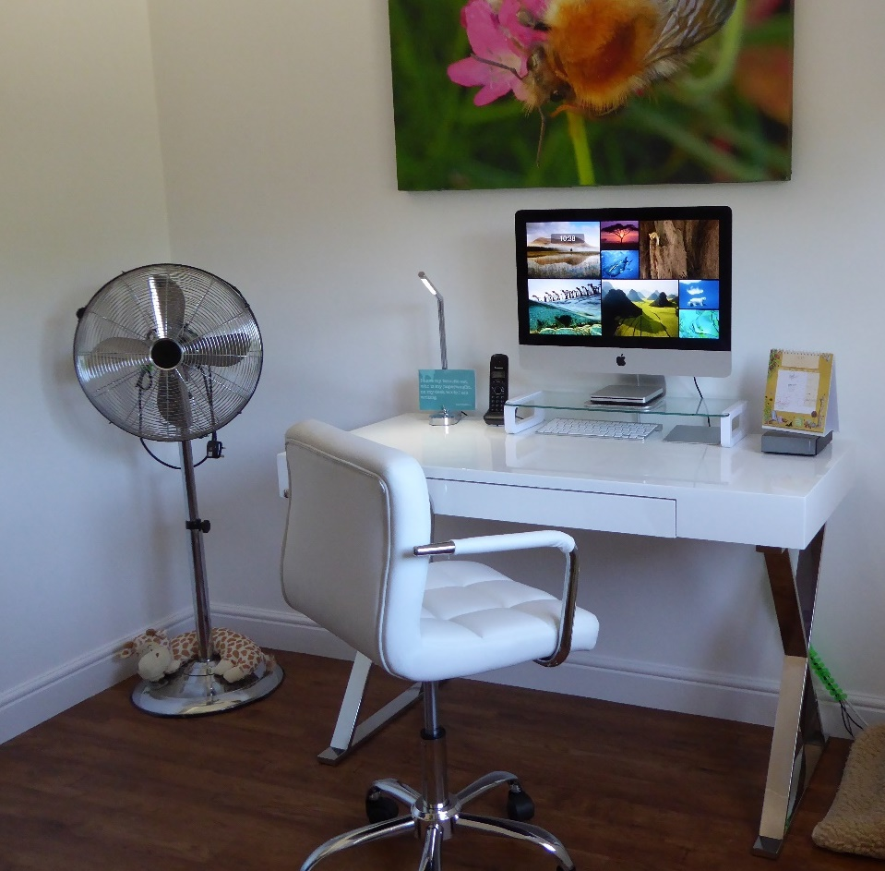
Fan cooling
Describe what you did in Activity 3 (make a cooling fan).
Demonstrate how the electric circuit is connected up and switched on.
What do you feel if you put your hand in front of the fan?
How about if you wet your fingers first?
Notes:
Ask pupils to explain what they did in Activity 3 (make a cooling fan).
Because the blades of the fan are positioned at an angle to the air, as they rotate they also push the air forwards, resulting in a stream of air.
Your body gives off heat to the surrounding air. The fan blows this warm air away and replaces it with cooler air, make you feel cooler.
If you wet your fingers and put them in front of the fan the airstream helps the water evaporate from your fingers, making them feel even cooler. For more information on evaporative cooling see the next slide.
Fans are much cheaper to install and run than air conditioning. Fans use much less electricity than air conditioning – air conditioning has a high carbon footprint (unless it is powered by renewable electricity). However air conditioning is more effective in actually cooling the room.
Photo with pedestal fan from PxHere (link: https://pxhere.com/en/photo/493370)

Slide 7
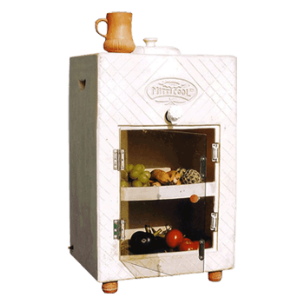
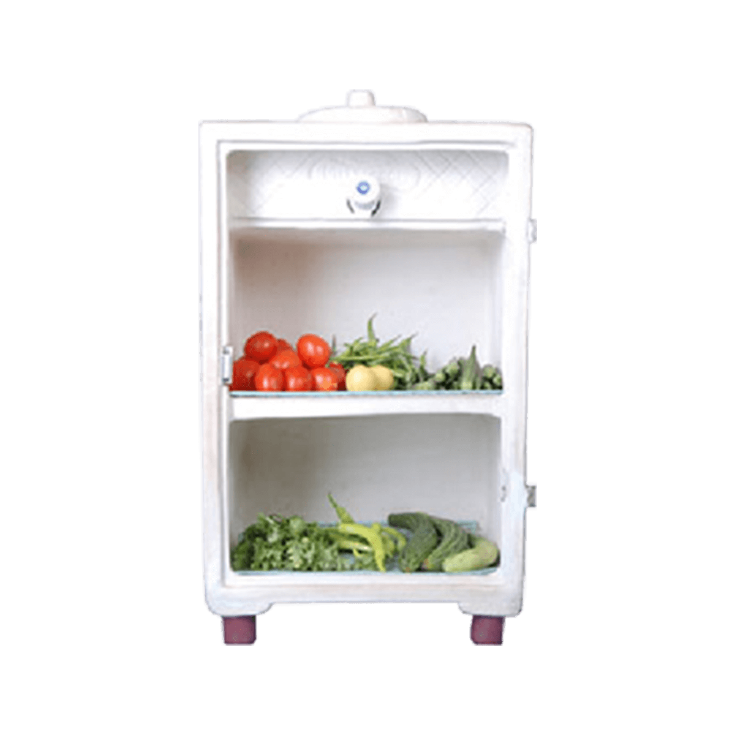
Evaporative cooling
Describe what you did in Activity 4 (make an evaporative cooler).
By how much did evaporative cooling reduce the temperature?
How does this clay fridge from Mitticool in India work?
Notes:
Ask pupils to explain what they did in Activity 4 (make an evaporative cooler).
To ensure a fair test, identical margarine tubs were used, the same amount of water was added to the tub, it was placed in the same environment and the same thermometer was used.
The evaporative cooling effect should have reduced the temperature by several degrees Centigrade.
(When water evaporates it changes state, turning from a liquid into a gas. This change uses up heat energy so it provides a cooling effect to the surface from which the water evaporates.)
To increase the cooling effect you could try placing the tub being cooled in the shade, placing it in a more windy area or increase the surface area begin cooled, for example by using a flatter tub or by covering it in wet paper towel so that the sides are cooled as well as the top.
The clay fridge doesn’t need electricity – it works by evaporative cooling. Clay is porous so it absorbs water which then gradually evaporates and keeps the fridge cool.
Evaporative coolers can be used where there is no electricity or the supply is unreliable. Also where people can’t afford electrical refrigerators.
The photos of the Mitticool Clay Refrigerator are shown with permission of Mitticool Products, India (link: https://mitticool.com/product/mitticool-clay-refrigerator50-liter/)

Slide 8
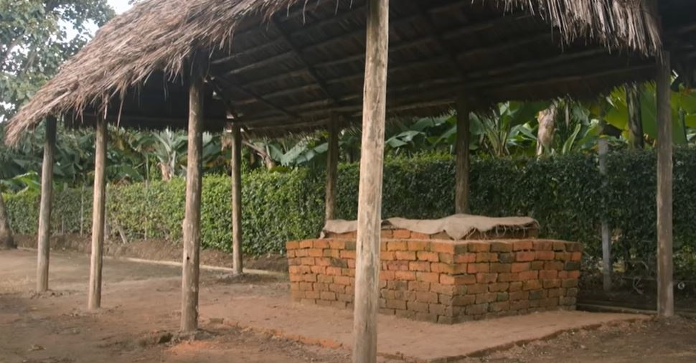
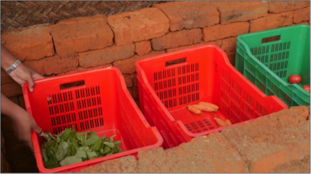
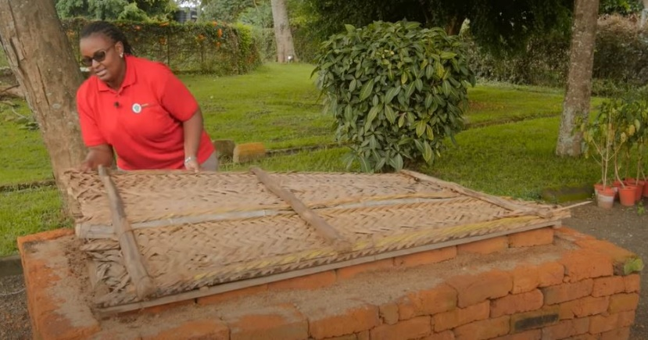
Evaporative cooling
This is an evaporative cooler used in Africa to store and preserve vegetables. It is built using locally available materials.
Notes:
The sides are made from bricks which are porous and retain water.
The cover is made from dried palm leaves, banana leaves or grasses which also retain water.
If it is not built in the shade then a shelter is constructed around it to shade it from the sun.
It needs to be watered 3-4 times a day.
The photos are shown with permission of the World Vegetable Centre (link: https://www.youtube.com/watch?v=enOjVc-kN7Q)

Slide 9
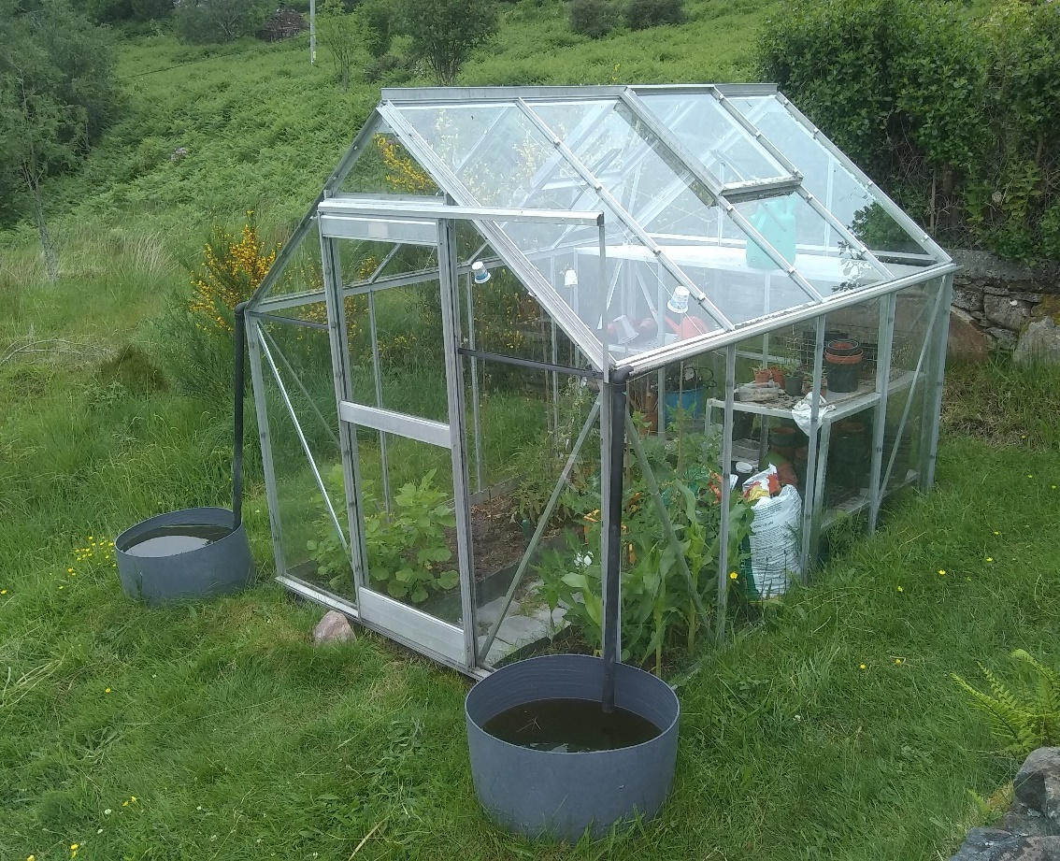
Rainwater harvesting
Describe what you did in Activity 5 (make a rainwater catcher).
What advantages are there to harvesting rainwater?
What can you use it for?
How could you catch more rainwater?
Notes:
Ask pupils to explain what they did in Activity 5 (make a rainwater catcher).
The cone is to increase the area which catches rainwater so that you catch more.
Card absorbs water, but plastic sheet does not. So a card cone would have gone soggy and not retained its shape.
Rainwater is free and using it helps reduce usage of mains water.
Harvesting rainwater can help reduce water shortages and flooding.
It is good for plants, and can be used for flushing toilets, washing clothes and cleaning.
It should not be used for drinking unless it has been properly treated.
You can catch more rainwater by using the rain which falls on a roof, as this has a much larger area for collecting the rainwater. You could also have a pond.
Ways to use less water include using rainwater to water plants, taking shorter showers, not leaving the tap on which brushing teeth, washing clothes less often, flushing your (home) toilet less often, minimise use of hosepipes.
In this photo the water which lands on the roof of the greenhouse runs along the gutters and down the downpipes into the water barrels. It is then used to water the plants.
This photo of a greenhouse with rainwater harvesting is by Jo Polak, Scotland.

Slide 10
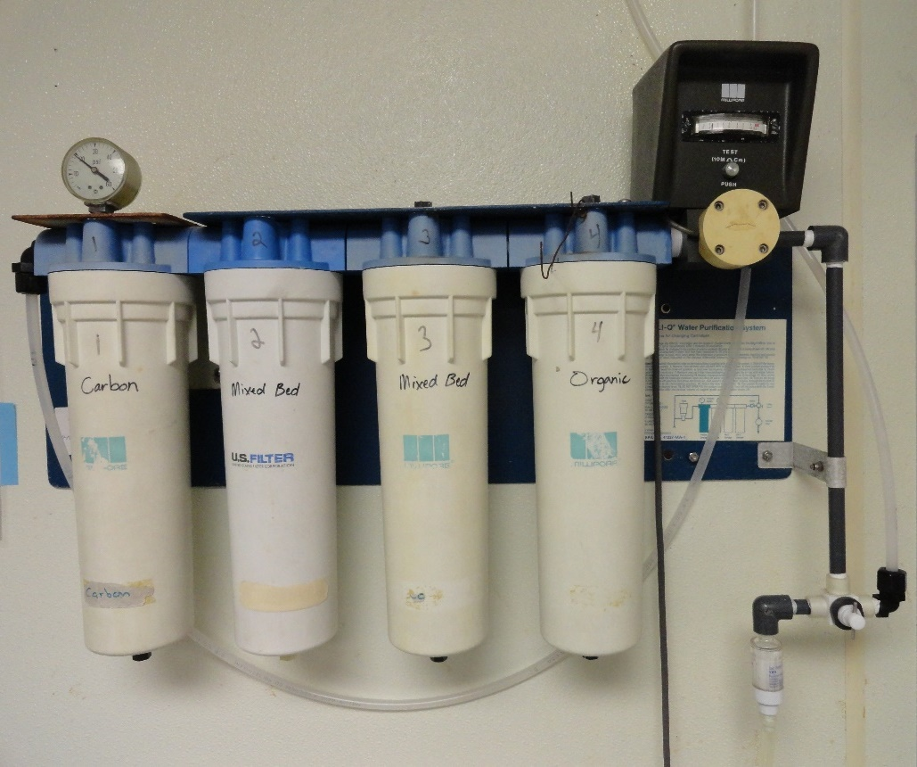
Filtering water
Describe what you did in Activity 6 (investigate water filtering).
Which filter worked the best?
Did it remove all the dirt from the water?
Why should you not drink water unless it has been properly treated?
Notes:
Ask pupils to explain what they did in Activity 6 (investigate rainwater filtering).
The coffee filter probably worked the best because it has smaller pores than the dishcloth. However even the coffee filter would not have removed all the dirt from the water.
Drinking untreated water can make you ill. Mechanical filtering alone does not remove all the pollutants from the water.
Lakes and rivers can contain waterborne infections (e.g. from animals) and other contamination (e.g. chemicals from agriculture).
The home water filtration system shown has four stages including two mechanical filters, a carbon filter and a biological filter.
The mechanical filters remove insoluble materials (along the lines of the filters made in Activity 6).
The carbon in the filter is highly porous and pollutants in the water get trapped in the pores.
The biological filter gets rid of micro-organisms in the water.
This photo is from Wikimedia (link: https://upload.wikimedia.org/wikipedia/commons/0/0a/Milli-Q_Water_filtration_station.JPG).

Slide 11
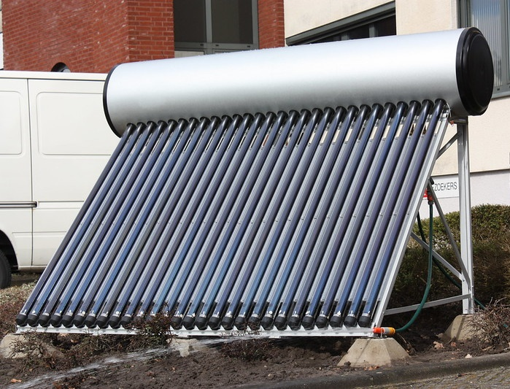
Low energy hot water
Describe what you did in Activity 7 (make a solar hot water heater).
What results did you obtain?
Suggest some ways to get your hot water to a higher temperature.
Why are the pipes on this solar collector black?
Notes:
Ask pupils to explain what they did in Activity 7 (make a solar hot water heater).
Water in the drinks cans will have absorbed energy from the sun and heated up.
The aluminium drinks can covered in black card should have got hotter than the one covered in white card.
Dark colours absorb more energy from the sunlight than light colours (see slide ‘keeping cool in summer’ for more details). Black is the best colour for a solar hot water heater. The black card will have got hotter, and the heat then conducted through the aluminium can and into the water.
Aluminium is a very good thermal conductor. If a poor thermal conductor were used then less of the heat would have transferred from the card through the material to the water.
Ways to get the water to a higher temperature include using a smaller quantity of water or darker card.
Another way to get water to a higher temperature is to increase the surface area being heated, for example by passing the water through lots of small pipes (known as a solar collector).
You can also orient the surface so that as much as possible is facing the sun.
The type of solar hot water heater shown is commonly mounted on roofs in hot climates.
In cooler climates you often have to boost the temperature, for example with a boiler or an immersion heater, in order to achieve a higher temperature. Therefore, in cooler climates, the solar collector is normally mounted on the roof but the water tank is inside.
The photo of the solar hot water heater is by Gerard Mourits on Flickr (link: https://www.flickr.com/photos/11066072@N06/4453385855)

Slide 12
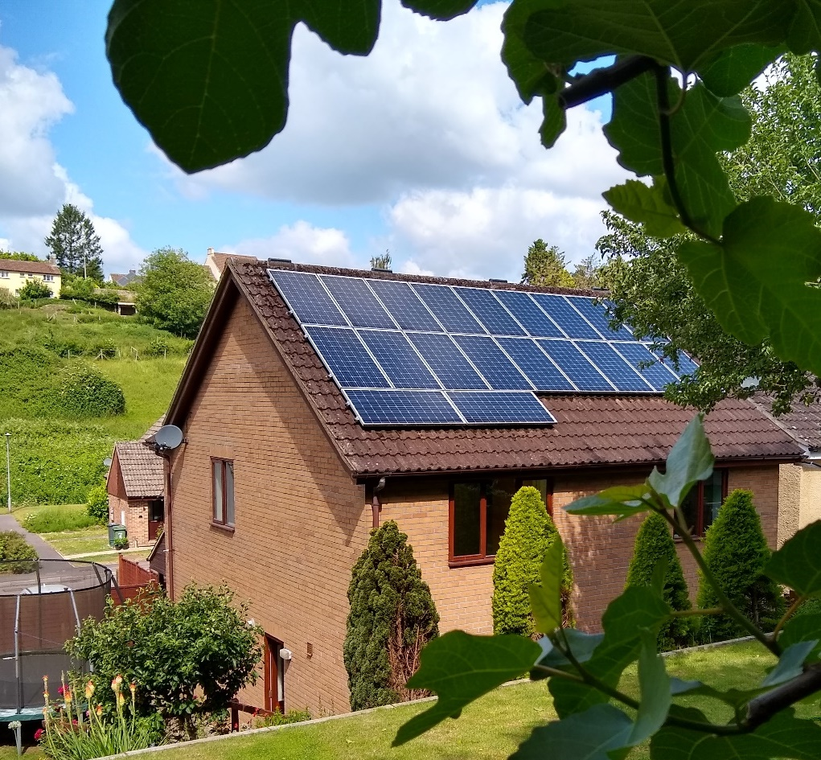
Solar PV panels
Describe what you did in Activity 8 (investigate solar PV).
What do solar PV panels do?
Do they work in the night?
How could you store the energy to use when you need it?
Notes:
Ask pupils to explain what they did in Activity 8 (investigate solar PV).
PV stands for ‘photovoltaic’. The solar PV panels use energy from the sun’s rays to produce electricity.
When it is dark the solar panels do not produce electricity.
They produce less electricity on days when it is cloudy.
You could install a battery to store your excess electricity so that you can use it when you need it.
However most houses in the UK are connected to the grid, so you can sell your spare electricity to the grid and then use electricity from the grid when you need it.
Some small farms and island communities are not connected to the grid so in addition to their renewable energy and battery storage they often have a back-up diesel powered generator to ensure that they are never without power.
A number of other methods of storing energy are mentioned in the slide ‘wind turbine’.
Solar panels are often roof-mounted because the roof is not being used for anything else. If you put them in your garden then you occupy space you might want for other things. Also the roof is often sloping at an appropriate angle to the sun and is less likely to be shaded because it is high up.
The photo of solar PV panels is by Alex Alliston, UK.

Slide 13
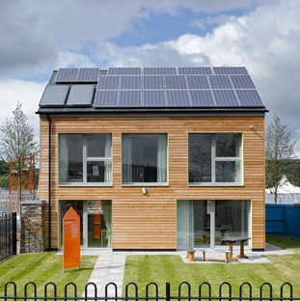
Minimising energy use
This is a ‘passive house’ – several features of the house help reduce energy usage.
Passive solar heating captures and keeps as much solar energy as possible.
Why are the windows so big?
What are mounted on the roof? What are they used for?
Notes:
A ‘passive house’ is an ultra-low energy building requiring little energy to heat or cool because the house is extremely well insulated and air-tight. It also naturally stores plenty of energy in its walls, making it easy to keep at an even temperature, trapping the sun’s heat in the day and releasing it slowly at night.
This house is intended for a cool climate and has large windows on the side that faces the sun (solar panels are mounted on the sunny side). The sun’s rays passing through the windows provide light and also heat up the rooms.
(It probably has smaller windows on the non-sunny side to conserve heat in winter. It probably has blinds on the sunny side to help avoid overheating in the summer.)
This house has a lot of solar PV panels to provide most of its electricity. It also has two solar collector panels which are used to heat water.
The photo of an affordable passive house is by Natural Building Technologies on Flickr (link: https://www.flickr.com/photos/naturalbuildingtech/8702180088)

Slide 14
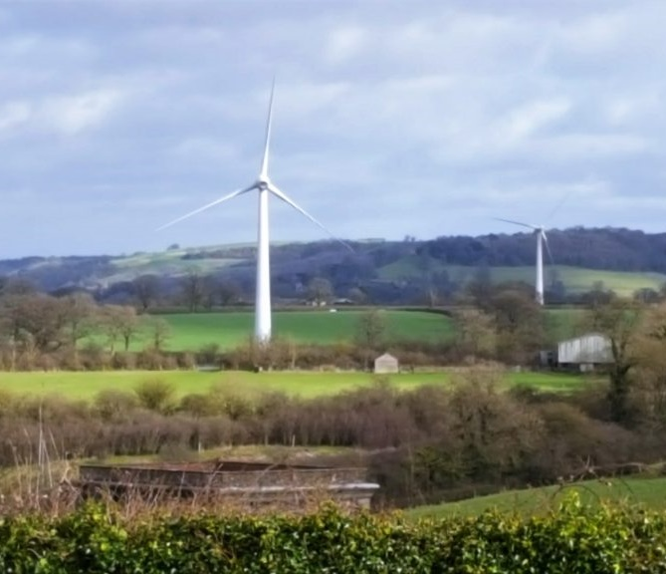
Wind turbine
Describe what you did in Activity 9 (make a wind turbine).
Did you encounter any difficulties? How did you overcome them?
What does a real wind turbine do?
Does it work all the time?
Notes:
Ask pupils to explain what they did in Activity 9 (make a wind turbine).
The air pushing against the curved turbine blades makes the turbine rotate.
Friction between the moving and stationary parts acts to slow the turbine down.
If you supply electricity to a motor then the motor shaft rotates. If you rotate the shaft of a motor then it will produce electricity – this is how an electrical generator works.
A real wind turbine converts kinetic (movement) energy from the wind into electrical energy. The model wind turbine does not produce electricity.
You need quite a large turbine to produce a meaningful amount of energy, so larger free standing turbine are more effective than small roof mounted ones.
Wind turbines need to be located where the wind is not obstructed by trees and other buildings.
Wind turbines only work when the wind is blowing. Most houses in the UK are connected to the grid and will not depend solely on wind energy.
Houses that are not grid-connected will often have a battery to store energy and/or a diesel-powered backup generator.
There are a number of ways of storing energy to be used when needed which exist or are currently being developed. These include huge batteries, pumped storage (pumping water uphill to a reservoir), compressed air, giants flywheels, huge weights being lifted in mine shafts, storing energy as heat, and splitting water into hydrogen and oxygen, then using the hydrogen e.g. in fuel cells.
This photo of community-owned wind turbines is shown with the permission of Resilient Energy Mounteneys Renewables, UK.

Slide 15
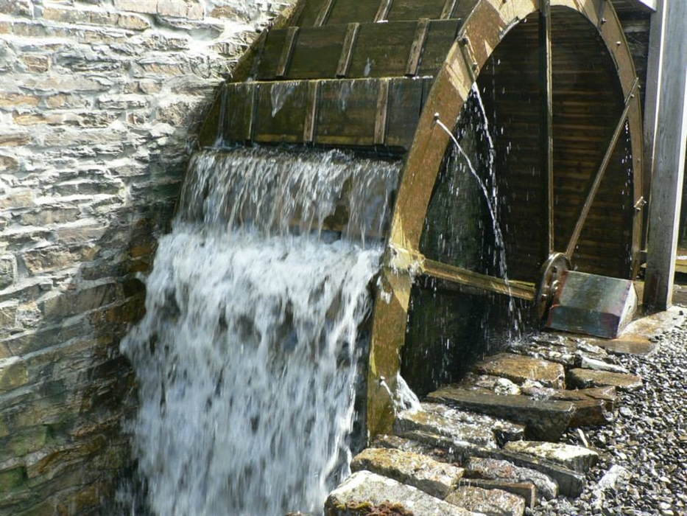
Water wheel
Describe what you did in Activity 10 (make a water wheel).
How does a water wheel work?
What were water wheels used for in the past?
Notes:
Ask pupils to explain what they did in Activity 10 (make a water wheel).
The water wheel converts energy from the moving water into mechanical work.
The water pushes the wheel round, and this is used to drive things such as grind stones for processing grain or large hammers for metalworking amongst other things.
Water wheels have been used in China for thousands of years. They were also used by the ancient Greeks and the Romans.
The photo here is from a working water-driven flour mill; Barony Mill on the island of Orkney, Scotland.
The photo of a water wheel is shown with permission of Barony Mill (link: https://baronymill.com/)

Slide 16
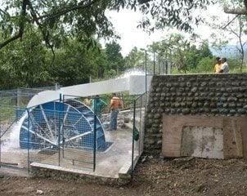
Water wheel to generate electricity
Modern water wheels and turbines are used to generate electricity.
This water wheel supplies power to forty households.
What if you don’t have water flowing through your property?
Notes:
Modern water wheels and turbines turn energy from moving water into electricity.
If your property doesn’t have water flowing through it then you won’t be able to use a water wheel to produce electricity!
You would need quite a lot of water flow or a large vertical fall of water (i.e. plenty of kinetic or potential energy) to produce a meaningful amount of electricity.
The water wheel in the photo supplies power to 40 households in the Philippines.
The photo of a water wheel is shown with permission of Edvard Csanyi of EEP (link: https://electrical-engineering-portal.com/what-would-be-the-cost-of-micro-hydro-plant)

Slide 17
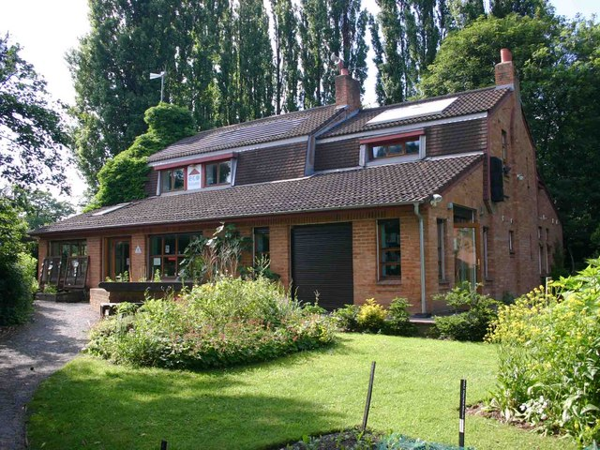
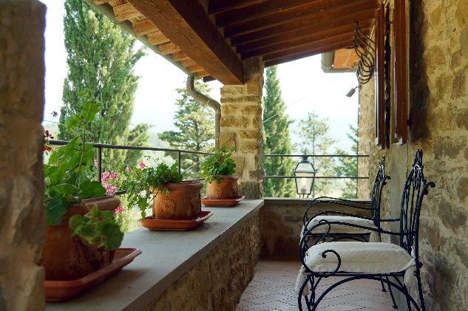
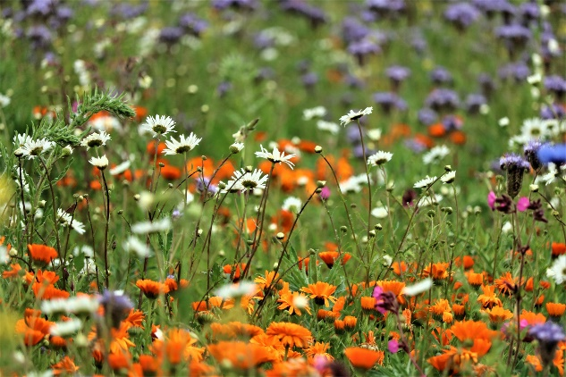
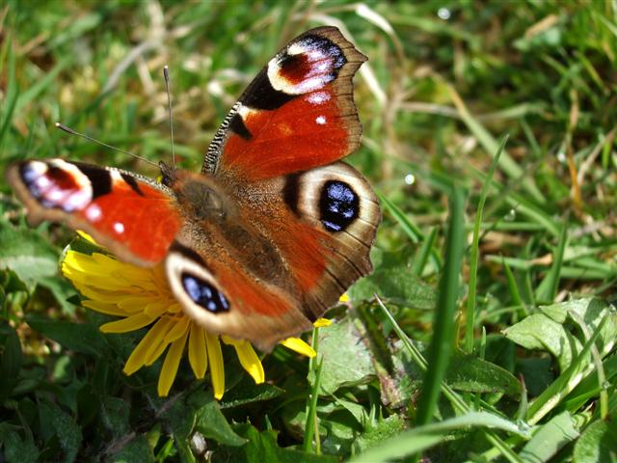
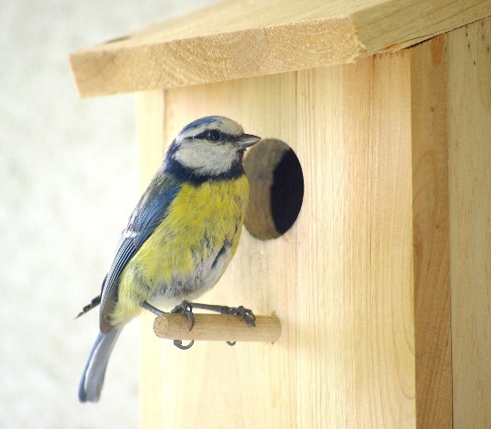
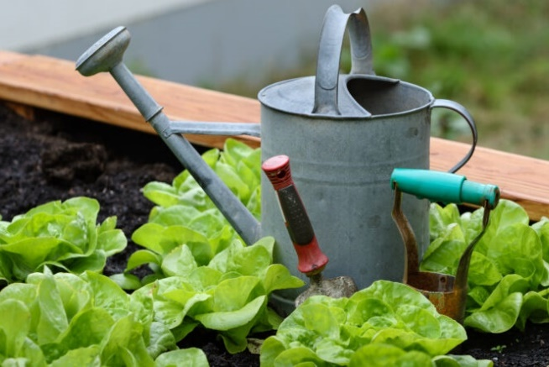
Using your outdoor space
Notes:
Think about how to use your outdoor space.
You could have trees to shelter the house from wind and rain; however be careful they don’t obstruct your solar panels and solar heating/lighting.
You may want a veranda, patio, sun room or conservatory.
You may want a place to store your bicycle or charge your electric car, bicycle or scooter.
You could have wild flowers to encourage insect life and biodiversity. You could have bird boxes and bird feeders.
You might want to grow some of your own food.
The photo of the eco-house is by © David P Howard (cc-by-sa/2.0) (link: https://www.geograph.org.uk/reuse.php?id=1915438)
The veranda photo is from PxHere (link: https://pxhere.com/en/photo/604738)
The wildflowers photo is from Jeyaratnam Caniceus on Pixabay (link: https://pixabay.com/photos/wild-flower-biodiversity-nature-5215763/)
The photo of a peacock butterfly is from Wikimedia (link: https://tinyurl.com/a2dyfswd).
The photo of a blue tit is from Pixabay (link: https://pixabay.com/photos/blue-tit-nesting-box-songbird-4024591/)
The gardening photo is from Click-Liverpool (link: https://www.clickliverpool.com/features/40748-5-ways-to-get-your-garden-ready-for-spring/).

Slide 18
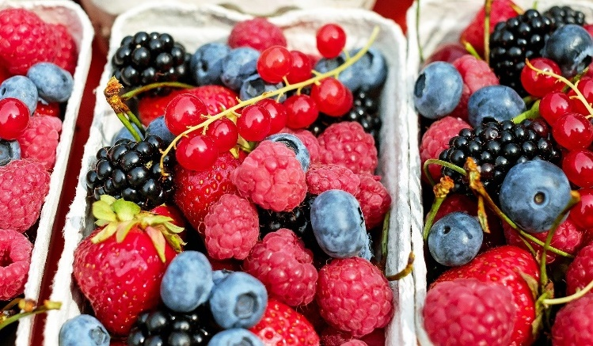
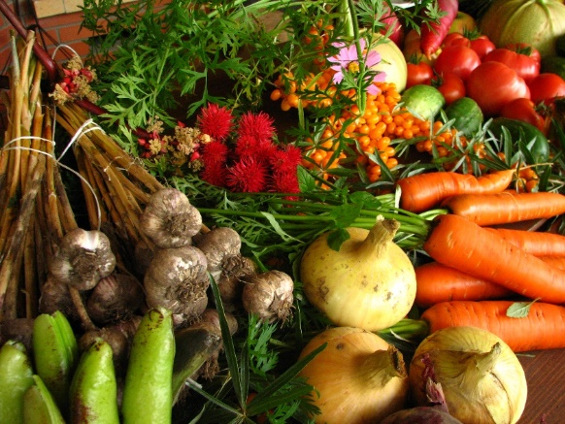
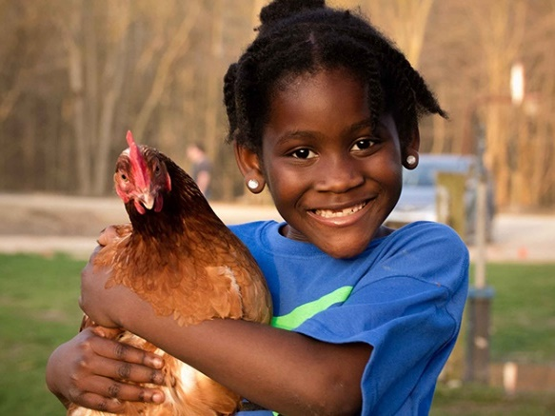
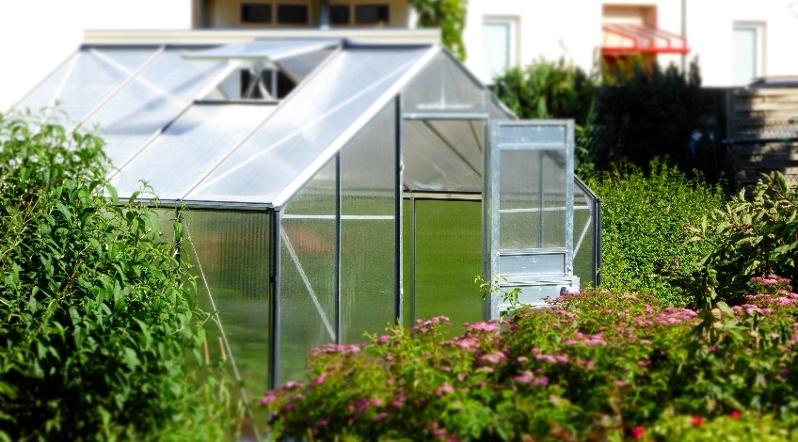
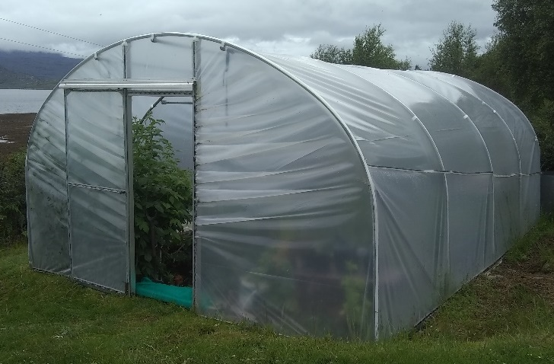
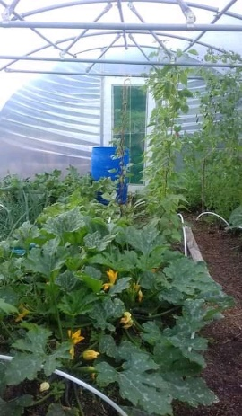
Growing your own food
Notes:
You could grow your own fruit and vegetables.
Perhaps you could keep chickens and have your own eggs.
If you want to extend the growing season or grow crops which normally only grow in a warmer climate you could use a greenhouse or polytunnel which uses passive solar heating.
You might need a compost heap and a shed to store your gardening equipment.
The berries photo is by Couleur from Pixabay (link: https://pixabay.com/photos/berries-fruits-raspberries-1546125/).
The vegetables photo is from Wikimedia (link: https://upload.wikimedia.org/wikipedia/commons/f/fa/Ecologically_grown_vegetables.jpg).
The chicken photo is by Steven Depolo (link: https://tinyurl.com/22b7f7za).
The greenhouse photo is from PxHere (link: https://pxhere.com/en/photo/712828).
The photos of the outside and inside of a polytunnel are by Jo Polak, Scotland.

Slide 19
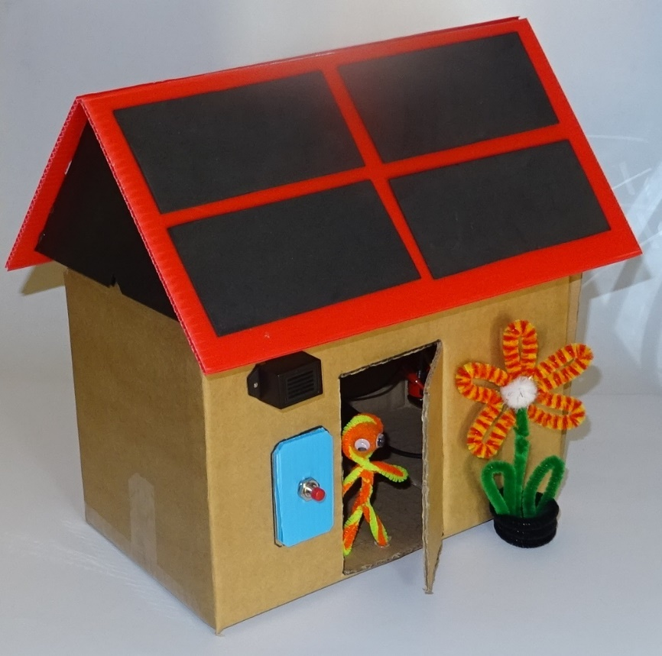
Decide on your design criteria
Your design criteria are your list of requirements for the design of your eco-home.
What do you feel are the most important requirements to you?
Discuss these with a partner, then write them down.
What else would you like to include if possible? Write these down as well.
Notes:
Some examples of design criteria for the eco-home are:
Minimising environmental impact
Comfortable to live in, e.g. warm enough in winter and cool enough in summer
Minimising energy usage
Well insulated
Cheap to run
Outside space to grow food
Producing your own renewable energy
Looks nice
Encourages biodiversity
Made of local sustainable materials (e.g. wood or local stone structure and sheep’s wool insulation)
Maximises use of rainwater
Off grid house (water, electricity, gas)

Slide 20
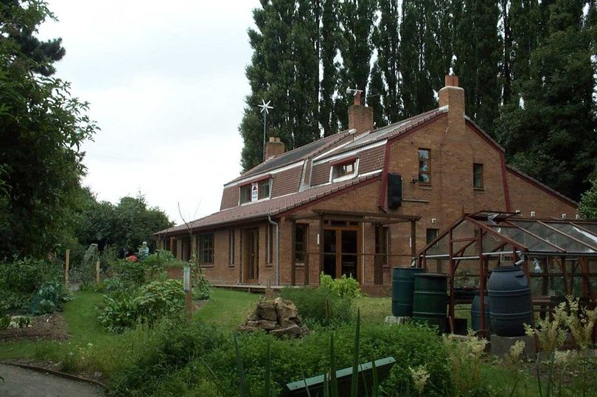
Design your own eco-home
Visualise your own eco-home which meets your design criteria.
Make a sketch and label all the eco-friendly features you have included.
Explain your design to others.
Copyright © Caroline Alliston 2021
Notes:
First ask the pupils to try and imagine what their eco-home will look like.
They then need to make an annotated sketch.
Encourage them to add plenty of eco-friendly features.
They don’t have to stick to existing ideas - they can come up with their own unusual suggestions (e.g. paint which changes from dark to light with increasing temperature).
They don’t need to stick rigidly to their design criteria.
They could explain their designs to one another or present them to the whole class.
If you have time the pupils could make a model of their home, e.g. using a cardboard box and a variety of craft materials.
They can then include any models they produced when completing the activity cards.
This photo of an eco-house is shown with permission of the Leicester Mercury (link: https://tinyurl.com/2sa2xeb9)

Slide 21
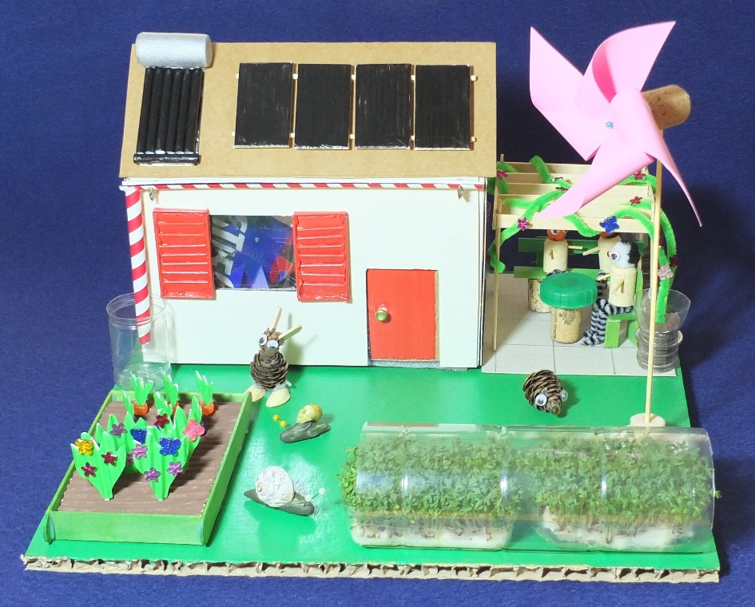
An example of a model eco-home
Solar hot water heater Solar PV panels Wind turbine
Loft insulation (bubble wrap)
Double glazing
Shutters to keep cool
Fan cooling
Rainwater harvesting
Raised bed with bee & butterfly friendly flowers and home grown vegetables
Wildlife friendly garden to promote biodiversity
External wall insulation (foam packaging) and cladding (cereal box), painted white for cooling
Underfloor insulation
Patio with natural plant shading and furniture made from recycled materials
Polytunnel used to extend crop season
Copyright © Caroline Alliston 2021
Notes:
Here is an example of a model eco-home.
This photo is by Alex Alliston.

